Slide 1

Global Health Technologies Coalition &
The O’Neill Institute
Better together? Exploring the proposal for a pooled fund for global health research and development
February 29, 2016
www.GHTCoalition.org

Slide 2
Health Product R&D Fund: a proposal for financing and operation
TDR report to be published 17 March 2016
http://www.who.int/tdr/capacity/gap_analysis/en/
Robert Terry, Manager, Knowledge Management, TDR
terryr@who.int

Slide 3
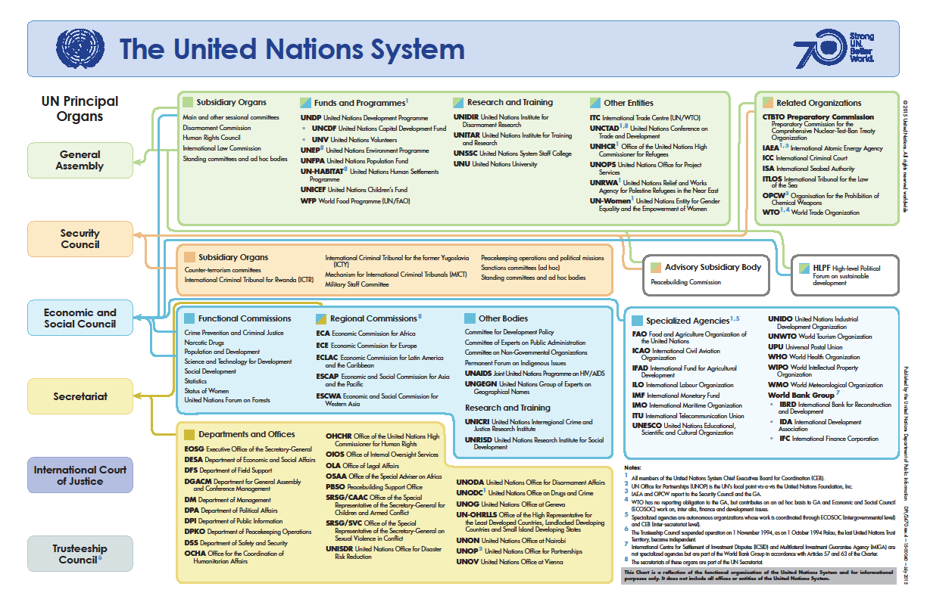

Slide 4
^{WHO established 1948}
Primary role is to direct and coordinate international health within the United Nations’ system.
Main areas of work:
- Health systems - Promoting health through the life-course
- Noncommunicable diseases - Communicable diseases
- Corporate services - Preparedness, surveillance and response.
Research in the constitution: Chapter II, Functions, Articles
(n) to promote and conduct research in the field of health;
…only18 pages

Slide 5
Overview of Research at WHO
35+ depts research activities.

Slide 6
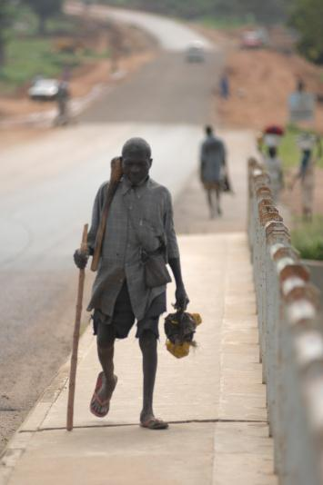
Special Programme for Research and Training in Tropical Diseases
Established 1974 with two objectives:
developing improved tools for the control of tropical diseases
strengthening research capacity of affected countries themselves.
TDR: hosted by the World Health Organization (WHO)
co-sponsored: UNICEF, UNDP, World Bank and WHO.
TDR within UN family in a unique position to play a pivotal role as a catalyst, facilitator and advisor in the global health research debate.

Slide 7
The Neglected diseases - a persistent problem.
“...a significant proportion of the world’s population, especially in developing countries, has yet to derive much benefit from innovations that are commonplace elsewhere. The reasons range from weak supply systems to unaffordable prices. The factors that drive innovation are often biased against conditions that disproportionately affect the populations of developing countries. ... Innovation to address conditions primarily affecting poor people is held back by a combination of market failure and underinvestment by the public sector. The process of bringing a new product to the market is both expensive and lengthy. Because of the resource implications and the uncertainties involved, creating an environment conducive to successful innovation is essential.”
Statement from WHA in 2003 – but still as relevant today

Slide 8

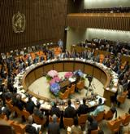
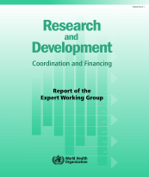
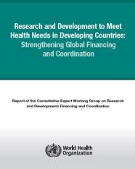
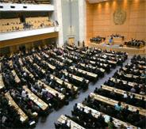
A BIT of History…
Starting point: high prices for ARTs, IP and no access to technology for generics.
As IP unable to be amended looked at R&D and then widened to include innovation cycle. How to incentivise R&D where no market?
Resolution WHA56.27
Resolution WHA59.24
2003
Resolution WHA61.21
Resolution WHA63.28
2006
Amend IP
Resolution WHA66.22
2008
R&D Observatory
Coordinating mechanism
TDR managed pooled fund
Support for R&D
2010
2013
Support for innovation

Slide 9
R&D product financing
67th WHA decision – request to TDR explore financing for product R&D
    Type III diseases found mostly in developing countries;
    Type II diseases that are in all countries, but the disease burden is greatest in the poorest; and
    Type I diseases that occur in all countries but where the R&D needs in developing countries are not being met.
Report to inform Member State meeting May 2016.
Covers 3 areas:
Modelling a financial mechanism to support health product R&D
  Portfolio-to-Impact tool (P2I)
  Scenarios showing funding preclinicalto launch $1 - - - - - $500 million
Mapping the health product pipeline - a compendium of Target Product Profiles
Managing an R&D portfolio – using expertise and incentivizing innovation

Slide 10



















































Interviewed 100+ stakeholders representing 70+ organizations data collection and analysis undertaken with McKinsey & Company

Slide 11
Heterogeneity is driven primarily by whether or not R&D financing and commercial market mechanisms exist
1
Meaningful commercial market
  Meaningful commercial market exists in the developed world: relatively larger pipelines because industry is incentivized to invest in R&D, thereby also benefiting LMICs (e.g., HIV/AIDS, hepatitis C)
HIV
1
  Global public health (GPH) market mechanisms creating a commercial market: donor organizations (e.g., Global Fund, GAVI, etc.) provide funding (or directly procure) products, creating visible demand and incentivizing research (e.g., TB, malaria, pneumococcal vaccine)
2
TB, malaria
2
  Global public health market mechanisms and middle-income country interest: some commercial markets developed through combination of middle-income country self-financing and interest (e.g., dengue or other vaccines common across global immunization schedules such as diphtheria, pertussis)
3
Dengue
3
4
  No commercial market or market mechanisms exist: most other Type III and Type II diseases with limited R&D investment have very few assets in the development pipeline (e.g., NTDs like schistosomiasis, hookworm disease)
No commercial market or market mechanisms
NTDs (e.g., Schisto.)
4
Little pipeline
Large pipeline
  Even diseases with larger pipelines, such as HIV/AIDS or Malaria, still have serious and specific unmet needs
  This underscores the need to identify gaps for all Type III and II diseases
  A full review would be performed by the WHO Global Observatory on Health R&D

Slide 12

The Portfolio-To-Impact (P2I) Model calculates the expected pipeline and associated costs based on a desired portfolio of compounds
  User inputs
  Disease and desired intervention (archetype)
  Number of candidates at desired phase
  Start date
  Phases funded
  Model outputs
  Expected number of launches
  Number of assets in pipeline over time
  Financial model
  Underlying assumptions
  Total cost (per year per phase)
  Fund costs vs. costs of other funders
  Cost per phase
  Probability of success per phase
If made publicly available, the model could also be used by other organizations as a portfolio management tool
  Length of phase

Slide 13
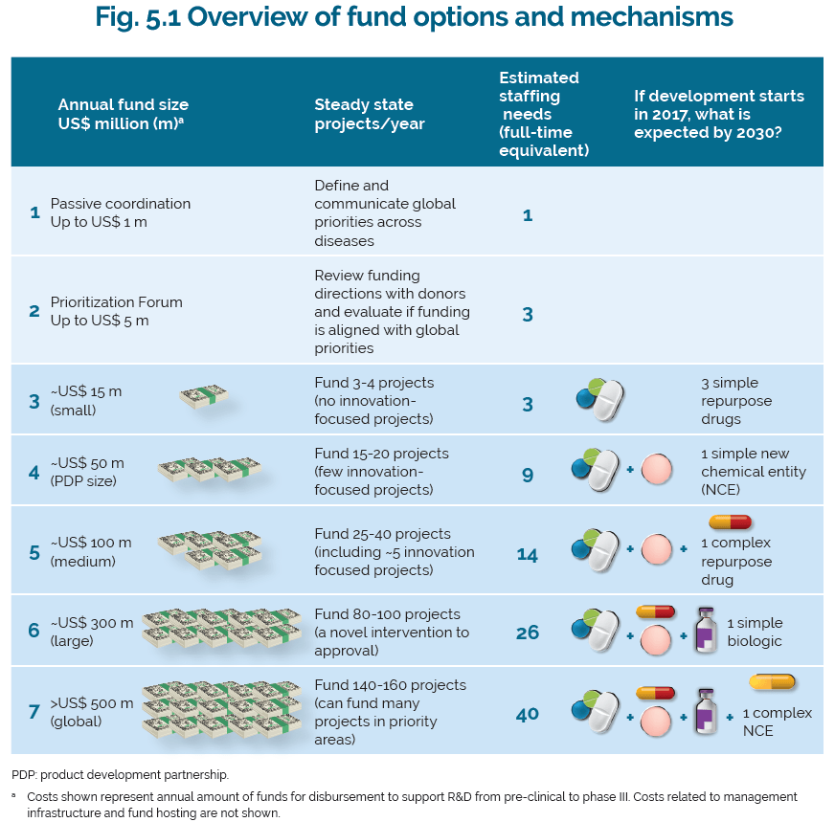

Slide 14
Evaluating options in terms of a spectrum of financing focus strategies informs the potential of each option
Repurposed interventions
Novel interventions
“Quick Wins”
“Mixed Model”
“Focused Innovation”
A
B
C
Investment focus
  Fund only finances simple drug repurposing projects
  Fund finances multiple projects across several different archetypes
  Fund only finances complex NCE projects
Basis for strategy
  Several PDPs focus on simple repurposings as a cost-effective and quick way to deliver products
  Some diversified funds finance multiple interventions across several diseases
  Some diseases will require completely novel treatments rather than repurposings

Slide 15
TDR led Activities to develop the R&D fund
Create a compendium of TTPs (target product profiles)
      What is already covered– by who – proxy for priorities – aim for greater harmonization
      Greater precision in articulating priorities
      Understand the global ask

Slide 16
Target Product Profile structure for therapeutic (Rx) products
Details/ example attribute description
Context and product overview
Indication
  Product indication
Product
  Overall product description (e.g. single vs. combination drugs)
Target populations
  Patient populations
Target setting for deployment
  Target countries
Patient access
Formulation
  Drug formulation
Route of administration
  Route of Administration
Dosing regimen
  Dosing schedule/Pill burden
Use setting
  Clinical use/convenience
Price
  Cost per treatment / Total cost per patient
Product performance
Clinical characteristics
  Clinical efficacy (day 7) /(day 28)
  Rate of onset of action
  Bioavailability
  Relapse prevention
Microbiological characteristics
  Transmission blocking
  Proportional reduction in parasite Load
  Resistance
  Specificity
Safety
  Clinical safety and tolerability, ssafety monitoring requirement
  Safety in special populations/ contraindications (pregnancy, infants)
Interactions
  Drug-drug interactions
  Compatibility with potential partner drugs
Shelf life, stability
  Storage requirements /Shelf life, stability
Other characteristics
Other characteristics
  Other

Slide 17
Target Product Profile structure for vaccine (Vx) products
Details/ example attribute description
Context and product overview
Indication
  Product indication
Product
  Product presentation/ description (e.g. vial size, mono/multi dose)
Target populations
  Target population/target age groups
Target setting for deployment
  Target countries/ geographic coverage
Patient access
Formulation
  Formulation
Route of administration
  Delivery route/ route of administration
Dosing regimen
  Dosage schedule/regimen/adherence
Use setting
  Use setting
Price
  Yearly product cost per user/ target price
Product performance
Clinical characteristics
  Expected efficacy
  Duration
  Reversibility
  Immunogenicity
Microbiological characteristics
  Vaccine serotypes, strain coverage
Safety
  Safety, reactogenicity and contra-indications
  Warnings and precautions/pregnancy and lactation
Interactions
  Interference and co-administration with other vaccines
Shelf life, stability
  Shelf life
  Storage and cold chain requirements
Other characteristics
Other characteristics
  Product registration and WHO prequalification
  Post marketing surveillance
  Disposal, waste
  Time to licensure, Possible Franchise
  Packaging and labeling

Slide 18
Target Product Profile structure for diagnostic (Dx) products (1/2)
Details/ example attribute description
Context and product overview
Indication
  Indication
Use case
  Intended use (e.g. monitoring prevalence, post-elimination surv.)
Target populations
  Target populations
Target setting for deployment
  Target countries/ geographic coverage
Product presentation
  Platform, Analyte (diagnostic biomarker)
Other information
  Clinical and/or surveillance need (value proposition)
  Fit with clinical workflow/ linkage to action (process map)
  Availability of ideal diagnostic marker
  Comparative reference method/Reference Test
Patient access
Location of use
  Infrastructure level requirements
Target user
  Patient/ health worker
  Level of training needed to conduct analysis (none, consistent w/ tier 2 facility)
Sample type and volume
  Blood, stool, etc.
Sample handling
  Sample preparation, Possible sampling strategies
  Sample transport stability
Price
  Price for individual test
  Capital cost of instrument
Supply
  Channels to market
  Supply, service, and support

Slide 19
Using Product profiles as an R&D Map
LAUNCH DATE
$ FUND GAP
STAGE I, II, III
$ CURRENT
SPONSOR
DISEASE
Product profiles

Slide 20
TDR led Activities to develop the R&D fund
Creation of a Scientific Working Group
    Managing conflict of interest but not excluding expertise (PDPs, industry) - high profile credible group
    Stop / go decisions

Slide 21
NEW R&D FUND UNDER WHO MANAGED BY TDR - A PROPOSAL
WORLD HEALTH ASSEMBLY / MEMBER STATES
- Oversight - Funds
POOLED
PROJECTS
R&D
FUND
COORDINATION MECHANISM
GOVERNANCE
TDR - JCB
Priority Setting
Reporting
WHO
TDR
R&D
OBSERVATORY
PROJECT MANAGEMENT
Data/Information Collection
Selection, Monitoring
& Evaluation
NEW TECHNOLOGIES – IMPROVED ACCESS - BETTER HEALTH

Slide 22
WHO pooled fund for health R&D
Strengths
Challenges
1st Global negotiated R&D fund
Global targets / priorities
TDR experience and networks
Disease endemic and donor countries part of governance
One funder process (efficiency)
Potential leverage of funds LMICs
Shared risk & shared success
Access (delinkage) a key focus of fund
Support for open innovation
Mixes technical & political agenda
Size and sustainability of fund
Flexibility (Emergency preparedness, Amr
Voluntary contributions
Are timescales realistic
Is the impact realistic

Slide 23



Demonstration projects
WHO oversees the projects – already chosen by WHA process
Pathogen Box $1.36 m VL € 2.34 m Diagnostics $1.6 m
WHO Global Health R&D Observatory $1 m
TDR oversees the fund with advice of ad hoc committee.
JCB provides governance over process and reports to WHA.
Approx. $10 million in 2014-16
Norway and Switzerland matched funding $1 : $2 from LMICs
NEW funds received from LMICs (Brazil, India, S Africa,)

Slide 24
Report conclusions & recommendations (1)
  Fund of sufficient scale (e.g., $100M annually) can drive R&D forward, going beyond the increasingly scarce low-hanging fruits of drug repurposing
    Regardless of the size and form of the future R&D financing mechanism, operational learnings (e.g., SWG setup and portfolio management approach) and developed tools (e.g., P2I Model and TPP compendium) will be useful for the public health and R&D community
  Portfolio of funded projects should be balanced between “quick wins” (e.g., drug repurposing) and efforts of longer duration (e.g., novel compounds, Vx or Dx) as well as between late and early pipeline

Slide 25
Report conclusions & recommendations (2)
  Need transparent, objective, and non-political decision-making; Clear transparent processes are needed, and the SWG members must be chosen for their scientific and technical expertise as well as for their experience in decision-making
  Fund must access “new” and additional sources of funding rather than simply pool funds that are already being used for R&D in diseases of poverty
    Fund’s objective decision-making approach and credibility and reach of WHO in setting priorities and in advocating for additional funding from member states/donors will help convince new funders to contribute

Slide 26
WHO and initiatives to support access to medicines
Global Strategy and Plan of Action on Public Health, Innovation and Intellectual Property
Essential Medicines List: includes patented drugs (cancer, Hep C)
Medicines Patent Pool HIV now expanded Hep C and TB
WTO, WIPO and WHO trilateral advice on trade, IP and health
UNCTAD, UNIDO & WHO framework for local production
R&D Blueprint for Emergency Preparedness
WHO & DNDi new facility for antibiotic development + Global Action Plan on Antimicrobial Resistance

Slide 27
Next Steps
January 2016: WHO Executive Board
17 March 2016: TDR report published
February 2016 submit to UN High Level Panel on access to medicines
3,4,5 May 2016: Member State meeting
May 2016: World Health Assembly
June 2016: R governance - Joint Coordinating Board Meeting
June 2017 UN High level panel on access to medicines

Slide 28
Global Health Technologies Coalition &
The O’Neill Institute
Better together? Exploring the proposal for a pooled fund for global health research and development
February 29, 2016
www.GHTCoalition.org

